Slide 1
Chapter 11
Agreement
Miller, Business Law Today Comprehensive Edition Text & Cases, 13th edition. © 2022 Cengage. All Rights Reserved. May not be scanned, copied or duplicated, or posted to a publicly accessible website, in whole or in part.

Slide 2
Chapter Objectives
By the end of this chapter, you should be able to:
Define offer.
List ways in which an offer may be properly revoked.
Describe the concept of sufficiency of consideration.
Explain the conditions that must be met for an offer to be legally accepted.
Explain the legality requirement in contract law.
Identify laws regulating electronic signatures.

Slide 3
Why Does Contractual Agreement Matter to Me?
For a contract to be considered valid and enforceable, four basic requirements—agreement, consideration, contractual capacity, and legality—must be met. The parties must agree on the terms of the contract and manifest to each other their mutual assent (agreement) to the same bargain. One party offers a certain bargain to another party, who then accepts that bargain.

Slide 4
Agreement
In today’s world, numerous contracts are formed via the Internet. When someone enters an online agreement with a cell phone company to purchase a smartphone and data plan, for instance, that person has entered into an electronic contract, or e-contract.
Notes:
Question: Ask students if they think Agreement is required to form a contract, whether it is formed in the traditional way (on paper) or online.
Answer: Responses will vary.

Slide 5
Six Flags, Inc. v. Steadfast Insurance Co., (2007)
Intent to be Bound
After a person was injured and nearly drowned on a water ride at one of its amusement parks, Six Flags, Inc., filed a lawsuit against the manufacturer that had designed the ride.
Required to Provide Insurance
The manufacturer claimed that the parties did not have a binding contract.
Notes:
The evidence included a faxed document specifying the details of the water ride, along with the parties’ subsequent actions (having begun construction, and written notes on the faxed document).

Slide 6
Six Flags, Inc. v. Steadfast Insurance Co., (2007) Polling Question
Did intention affect the outcome of a lawsuit between Six Flags and the manufacturer of a water ride?
Yes
No

Slide 7
Intention and Definiteness of the Offer
Agreements to Agree
May be enforceable if it is clear that the parties intended to be bound by the agreements.
Preliminary Agreements
Increasingly, the courts are holding that a preliminary agreement constitutes a binding contract if the parties have agreed on all essential terms, and no disputed issues remain to be resolved.
Definiteness
Generally, the contract must include:
The identification of the parties.
The identification of the object of the contract items like goods, services, and land.
The consideration to be paid.
The time of payment, delivery.
Notes:
Communication of the offer: the offer must be communicated to the offeree.

Slide 8
Termination of the Offer (1 of 4)
Termination by Action of the Parties
An offer can be terminated by action of the parties by revocation, by rejection, or by counteroffer.
Revocation – The withdrawal of a contract offer by the offeror. Revocation may be accomplished by either of the following:
Express repudiation of the offer
Performance of acts that are inconsistent with the existence of the offer, and are made known to the offeree

Slide 9
Termination of the Offer (2 of 4)
Termination by Action of the Parties
Irrevocable offers: some offers can be made irrevocable
Option contract: a contract under which the offeror cannot revoke the offer for a stipulated time period (because the offeree has given consideration for the offer to remain open)
Termination by Action of the Offeree
If the offeree rejects the offer, the offer is terminated.

Slide 10
Termination of the Offer (3 of 4)
Termination by Action of the Offeree
Rejection: a rejection is effective only when it is actually received by the offeror, or the offeror’s agent
Counteroffers: a rejection of the original offer, and the simultaneous making of a new offer
At common law, the mirror image rule requires that the offeree’s acceptance match the offeror’s offer exactly.

Slide 11
Termination of the Offer (4 of 4)
Termination by Operation of Law
Lapse of time: an offer terminates automatically by law when the period of time specified in the offer has passed
Destruction of specific subject matter: an offer is automatically terminated if the specific subject matter of the offer is destroyed before the offer is accepted
Notes:
Termination by Operation of Law
Death or incompetence: an offeree’s power of acceptance is terminated when the offeror or offeree dies, or becomes legally incapacitated, unless the offer is irrevocable.
Lapse of time: an offer terminates Supervening illegality (a statute or court decision that makes an offer automatically illegal, terminating the offer).

Slide 12
Discussion
Lee offers to lend Kim $10,000 at an annual interest rate of 15 percent. Before Kim can accept the offer, a law is enacted that prohibits interest rates higher than 8 percent. Lee’s offer is automatically terminated. What if the statute is enacted after Kim accepts the offer, is a valid contract is formed, is the contract enforceable?
Notes:
Divide students into small groups, and give them the following instructions to analyze and answer this discussion prompt.

Slide 13
Acceptance (1 of 3)
Unequivocal Acceptance
The offeree must accept unequivocally to exercise the power of acceptance effectively. An acceptance may be unequivocal even though the offeree expresses dissatisfaction with the contract.
An acceptance cannot impose new conditions, or change the terms of the original offer.
Notes:
An acceptance is a voluntary act by the offeree that shows assent (or agreement) to the terms of an offer by words (or conduct).
The acceptance must be unequivocal, and must be communicated to the offeror.
Generally, only the person to whom the offer is made (or that person’s agent) can accept the offer, and create a binding contract.

Slide 14
Offer
3 Elements needed for Offer to be Effective:
There must be a serious, objective intention by the offeror.
The terms of the offer must be reasonably certain, or definite, so that the parties and the court can ascertain the terms of the contract.
The offer must be communicated to the offeree.
Intention of the Offer
Intention is determined by what a reasonable person in the offeree’s position would conclude that the offeror’s words and actions meant.
Notes:
An offer is a promise (or commitment) to perform (or refrain from performing) some specified act in the future.
When Intent may be lacking
Expressions of opinion
Statements of future intent
Preliminary negotiations
Invitations to bid
Advertisements and price lists
Live and online auctions

Slide 15
Acceptance (2 of 3)
Silence as Acceptance
Ordinarily, silence cannot constitute acceptance, even if the offeror states this as part of the offer.
However, silence or inaction will operate as an acceptance in some instances if the offeree has a duty to speak.
Silence can also operate as an acceptance when the offeree has had prior dealings with the offeror.

Slide 16
Acceptance (3 of 3)
Communication of Acceptance
Unilateral contracts: full performance of some act is called for, acceptance is usually evident, and notification is unnecessary (unless required by law or offeror asks for it)
Bilateral contracts: communication of acceptance is necessary, because acceptance is in the form of a promise
Notes:
Mode and Timeliness of Acceptance:
The mailbox rule: acceptance is valid when it is dispatched through the mail.
Authorized means of communication: when an offeror specifies how acceptance should be made, the contract is not formed unless the offeree uses that mode of acceptance.
Substitute method of acceptance: the acceptance of an offer by a substitute method may still be effective, if that method serves the same purpose as the authorized means.

Slide 17
Brown v. Lagrange Development Corp., (2015)
Sonja Brown made a written offer to Lagrange Development to buy a house for $79,900. Lagrange’s Terry Glazer, penciled in changes to the offer—and increased the price to $84,200 and a later date for acceptance. Glazer initialed the changes and signed the document. Brown initialed the date change but not the price increase, and did not sign the revised contract. Brown went through with the sale and received ownership of the property.

Slide 18
Brown v. Lagrange Development Corp., (2015) Polling Question
Was the contract enforceable for the modified price?
Yes
No

Slide 19
E-Contracts and Online Offers
Electronic contracts, or e-contracts, must meet the same basic requirements (agreement, consideration, contractual capacity, and legality) as paper contracts.
Online contracts may be formed not only for the sale of goods and services, but also for licensing.
Displaying the Offer
The contract generally must be displayed online in a readable format, and all provisions should be reasonably clear.
Notes:
Provisions to Include
Acceptance of terms
Payment
Return policy
Disclaimer
Limitation on remedies
Privacy policy
Dispute resolution

Slide 20
Online Offers
Dispute-Settlement Provisions
Online offers frequently include provisions relating to dispute settlement.
Forum-Selection Clause
A provision in a contract designating the court, jurisdiction, or tribunal that will decide any disputes arising under the contract.
Dispute-Settlement Provisions
Choice-of law clause: a clause that specifies that any dispute arising out of the contract, will be settled in accordance with the law of a particular jurisdiction

Slide 21
Ecocards v. Tekstir, Inc., 2020
Rebecca Bextel developed a business plan to sell online greeting cards. She hired Tekstir, Inc., to develop the website. Several months later, Bextel filed suit against Tekstir in a Wyoming state court, claiming the company had failed to meet its contractual obligations.

Slide 22
Ecocards v. Tekstir, Inc., 2020 Polling Question
Do you agree with the contract that included a forum-selection clause requiring any disputes to be ligated in Orange County, California?
Yes
No

Slide 23
Online Acceptances
Click-On Agreements
An agreement that arises when an online buyer clicks on “I agree.”
Shrink-Wrap Agreements
Agreement terms are located inside a packaged box of goods.
Shrink-Wrap Agreements
Shrink-Wrap Agreements and Enforceable Contract Terms – A buyer’s failure to object to terms contained within a shrink-wrapped package may constitute an acceptance of the terms by conduct.
Notes:
Shrink-wrap terms that may not be enforced: some courts have refused to enforce certain terms, because the buyer did not expressly consent to them.
Browse-wrap terms
A term or condition of use that is presented when an online buyer downloads a product, but to which the buyer does not have to agree before installing or using the product.

Slide 24
Federal Law on E-Signatures and E-Documents
E-Signature: an electronic sound, symbol, or process attached to or logically associated with a record and adopted by a person with the intent to sign the record
The E-SIGN Act provides that no contract, record, or signature may be “denied legal effect” solely because it is in electronic form.
The act does not apply to court papers, divorce decrees, evictions, foreclosures, health-insurance terminations, prenuptial agreements, and wills.
Notes:
Partnering agreements: a partnering agreement reduces the likelihood of contract disputes, because the buyer and the seller have agreed in advance to the terms and conditions that will accompany each sale.

Slide 25
The Uniform Electronic Transactions Act (1 of 3)
The Scope and Applicability of the UETA
The act removes barriers to e-commerce by giving the same legal effect to electronic records and signatures as is given to paper versions.
The Federal E-SIGN Act and the UETA
If a state has enacted the UETA without modification, state law will govern.
The E-SIGN Act allows states to enact alternative requirements for the use of electronic records or electronic signatures.
Notes:
Highlights of the UETA
Attribution
If an electronic record or signature is the act of a particular person, the record or signature may be attributed to that person.
The Effect of Errors
The UETA encourages the use of security procedures to verify changes to electronic documents, and to correct errors.

Slide 26
The Uniform Electronic Transactions Act (2 of 3)
Highlights of the UETA
Timing
An electronic record is considered sent, when it is properly directed to the intended recipient in a form readable by the recipient’s computer system.
An electronic record is considered received, when it enters the recipient’s processing system in a readable form—even if no individual is aware of its receipt.

Slide 27
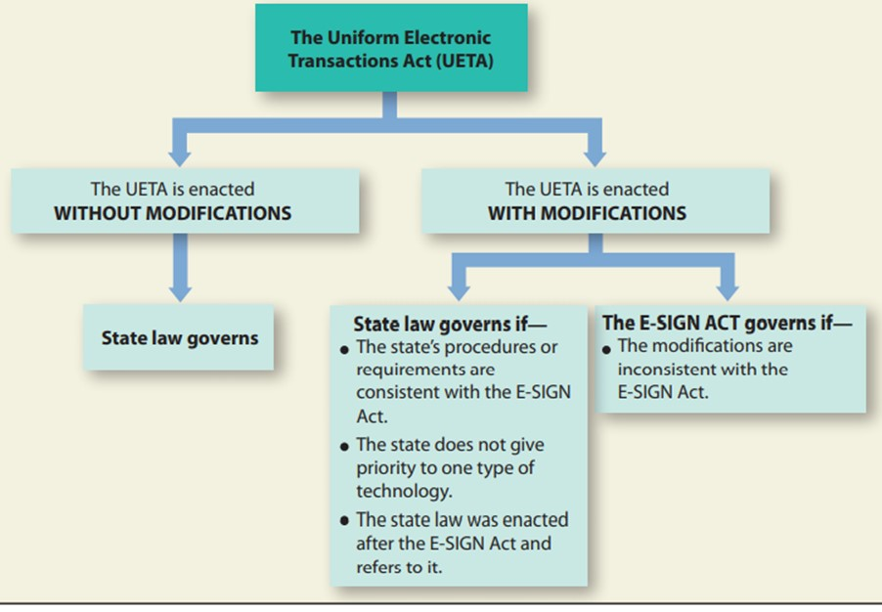
The Uniform Electronic Transactions Act (3 of 3)

Slide 28
Group Breakout: The Uniform Electronic Transactions Act
What is the primary purpose of the Uniform Electronic Transactions Act?
Notes:
Break students out into small groups, and have students discuss the questions posed on the slide.
The UETA has been adopted, at least in part, by forty-eight states.

Slide 29
Knowledge Check
What two events show there is evidence for agreement?
Notes:
The parties must agree on the terms of the contract, and manifest to each other their mutual assent (agreement) to the same bargain. Ordinarily, agreement is evidenced by two events: an offer and an acceptance.

Slide 30
Self-Assessment
What concepts did you find difficult, and thus need a review?
How might the topics in this chapter come up in the future in your personal (or work) life?
What could you do to improve your contributions in class discussion?

Slide 31
Summary
Now that the lesson has ended, you have learned to:
Define offer.
List ways in which an offer may be properly revoked.
Describe the concept of sufficiency of consideration.
Explain the conditions that must be met for an offer to be legally accepted.
Explain the legality requirement in contract law.
Identify laws regulating electronic signatures.

