Slide 1
Chapter 9
Criminal Law and Cyber Crime
Miller, Business Law Today Comprehensive Edition Text & Cases, 13th edition. © 2022 Cengage. All Rights Reserved. May not be scanned, copied or duplicated, or posted to a publicly accessible website, in whole or in part.

Slide 2
Chapter Objectives
By the end of this chapter, you should be able to:
Differentiate between actus reus, and mens rea.
Identify types of white collar crime.
List available defenses to criminal activity.
Summarize the constitutional protections for the criminal defendant.
Explain the burden of proof required in a criminal case.
Summarize criminal liability under the Federal Computer Fraud and Abuse Act.

Slide 3
Why Does Criminal Law and Cyber Crime Matter to Me?
Many statutes regulating business provide for criminal as well as civil sanctions. For instance, federal statutes that protect the environment often include criminal sanctions. Businesses that violate environmental laws can be criminally prosecuted. Walmart Inc., for example, was charged with illegally handling and disposing of hazardous materials (such as pesticides) at its retail stores across the nation. Walmart ultimately pleaded guilty to six counts of violating the Clean Water Act, and was sentenced to pay over $81 million in fines as a result.

Slide 4
Key Differences Between Civil Law and Criminal Law
ISSUE
Party who brings suit
Wrongful ac
Burden of proof
Verdict
Remedy
CIVIL LAW
Causing harm to a person or to a person’s property.
Preponderance of the evidence.
Three-fourths majority (typically).
Damages to compensate for the harm, or a decree to achieve an equitable result.
CRIMINAL LAW
The state.
Violating a statute that prohibits some type of activity.
Beyond a reasonable doubt, unanimous.

Slide 5
Briscoe v. State of Texas, 2018
In Texas, Chigger Ridge Ranch, L.P., operated a 700-acre commercial hunting area called Coyote Crossing Ranch (CCR). Chigger Ridge leased CCR and its assets for twelve months to George Briscoe’s company, VPW Management, LLC. The lease identified all of the vehicles and equipment that belonged to Chigger Ridge, which VPW could use in the course of business, but the lease did not convey any ownership interest. During the lease term, however, Briscoe told his employees to sell some of the vehicles and equipment. Briscoe did nothing to correct the buyers’ false impression that he owned the property, and was authorized to sell it. The buyers paid with checks, which were deposited into an account to which only Briscoe and his spouse had access.
How does the burden of proof differ in criminal versus civil cases?
Notes:
Which crime, if any, did Briscoe commit? Explain. [Briscoe v. State of Texas, 2018 WL 792255 (Tex.App.— Texarkana 2018)] (See Types of Crimes.)

Slide 6
Briscoe v. State of Texas, 2018 Polling Question
Do you think Briscoe committed a crime?
Yes
No
Notes:
Invite students to discuss their reasoning.

Slide 7
Civil Liability for Criminal Acts
Some torts, such as assault and battery, provide a basis for a criminal prosecution as well as a tort action.
The next Exhibit illustrates how the same act can result in both a tort action, and a criminal action against the wrongdoer.

Slide 8
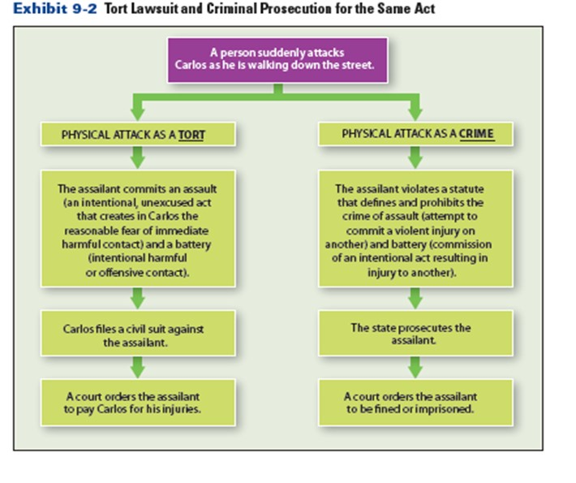
Classification of Crimes (1 of 2)
Exhibit 9-2 Tort Lawsuit and Criminal Prosecution for the Same Act

Slide 9
Classification of Crimes (2 of 2)
Felony: a crime—such as arson, murder, rape, or robbery—that carries the most severe sanctions, ranging from more than one year in a state or federal prison to the death penalty
Misdemeanor: a lesser crime than a felony, punishable by a fine or incarceration in jail for up to one year
Petty offense: the least serious kind of criminal offense, such as a traffic or building-code violation

Slide 10
United States v. Broussard
Heesham Broussard obtained counterfeit money instruments. To distribute them, he used account information and numbers on compromised FedEx accounts procured from hackers. Text messages from Broussard indicated that he had participated previously in a similar scam, and that he knew the packages would be delivered only if the FedEx accounts were “good.” For his use of the accounts, Broussard was charged with identity theft. In defense, he argued that the government could not prove he knew the misappropriated accounts belonged to real persons or businesses.

Slide 11
United States v. Broussard Polling Question
Does the evidence support Broussard’s assertion? From an ethical perspective, does it matter whether he knew that the accounts belonged to real customers?
Yes
No
Notes:
Invite students to discuss their reasoning with at another person or classmate.
A Question of Ethics: Assuming that FedEx knew its customers’ account information had been compromised, use the IDDR approach to consider whether the company had an ethical obligation to take steps to protect those customers from theft.

Slide 12
Criminal Liability
State of Mind
Strict Liability and Overcriminalization
  An increasing number of laws and regulations have imposed criminal sanctions for strict liability crimes. Critics say that such laws lead to overcriminalization.
  Federal crimes: the federal criminal code contains more than 4000 criminal offenses, and many do not require a specific mental state
  State crimes: many states also have laws that punish criminal behavior without the need to show criminal intent
Notes:
Notes: The Criminal Act
Actus reus: a guilty (prohibited) act
State of Mind
Mens rea: a wrongful mental state or intent
Recklessness: when a defendant consciously disregards a substantial and unjustifiable risk.
Criminal Negligence: when a defendant takes an unjustified, substantial, and foreseeable risk that results in harm.

Slide 13
Corporate Criminal Liability
Liability of the Corporate Entity
Corporations are normally liable for the crimes committed by their agents and employees within the course and scope of their employment.
Corporations can be held criminally liable when they FAIL to fulfill certain statutory duties.
Liability of Corporate Officers and Directors
Corporate directors and officers are personally liable for the crimes they commit—whether the crimes were committed for their personal benefit, or on the corporation’s behalf.
Under the responsible corporate officer doctrine, a court may impose criminal liability on a corporate officer regardless of whether she or he participated in, directed, or even knew about a given criminal violation.

Slide 14
United States v. Quality Egg, LLC (2015)
Austin DeCoster owned and controlled Quality Egg, LLC, an egg-production and processing company with facilities across Iowa. His son, Peter DeCoster, was the chief operating officer. Due to unsanitary conditions in some of its facilities, Quality Egg shipped and sold eggs that contained salmonella bacteria, which sickened thousands of people across the United States. The federal government prosecuted the DeCosters under the responsible corporate officer doctrine, in part for Quality’s failure to comply with regulations on egg-production facilities.
Notes:
The DeCosters ultimately pleaded guilty to violating three criminal statutes. But when they were ordered to serve three months in jail, the DeCosters challenged the sentence as unconstitutional. The court held that the sentence of incarceration was appropriate because the evidence suggested that the defendants knew about the unsanitary conditions in their processing plants.

Slide 15
United States v. Quality Egg, LLC (2015) Polling Question
If unsanitary conditions at an egg-production facility spark sickness among consumers, can the corporate owner be held criminally liable?
Yes
No
Notes:
Under the responsible corporate officer doctrine, a court may impose criminal liability on corporate officers regardless of whether they participated in, directed, or even knew about a given criminal violation.

Slide 16
Knowledge Check
Explain each of the five broad categories of crimes:
Violent crime (crimes against persons)
Property crime
Public order crime
White-collar crime
Organized crime
Notes:
Certain crimes are violent (crimes against persons), because they cause others harm or death.
Robbery, sexual assault, and murder are all violent crimes.
Each violent crime is further classified by degree, depending on the circumstances surrounding the criminal act.
Most commonly, it involves money or property
Burglary: unlawful entry
Larceny: erongful taking of another’s property
Obtaining Goods by False Pretenses
Case Example 9.9 State of Wisconsin v. Steffes (2013)
Receiving Stolen Goods
Arson: intentional burning of a building
Forgery: fraudulent making or altering of writing that changes legal rights of another
Public order crimes are typically “victimless” crimes. However, they are detrimental to society because they may create an environment that gives rise to property and violent crimes.
Most common include:
Public drunkenness
Prostitution
Gambling
Illegal drug use
White-Collar Crime: a nonviolent crime committed by individuals or business entities to obtain a personal or business advantage.
Embezzlement: fraudulent appropriation of funds
Mail and Wire Fraud: any scheme that uses the U.S. mail, commercial carriers, or wire (including telephone, e-mail and social media) with the intent to defraud the public
Bribery
Commercial bribery involves corrupt dealings between private persons or businesses.
Typically, people make commercial bribes to obtain proprietary information, cover up an inferior product, or secure new business.
The Foreign Corrupt Practices Act (FCPA)
Prohibits U.S. businesspersons from bribing foreign officials to secure beneficial contracts.
Firms can be fined—and individuals fined or imprisoned—for FCPA violations.
Bankruptcy Fraud
Theft of Trade Secrets: under the Economic Espionage Act, the theft of trade secrets is a federal crime.
Insider Trading: the purchase or sale of securities on basis of information not available to public.
Organized crime:
Money Laundering: engaging in financial transactions to conceal the identity, source, or destination of illegally gained funds.
The Racketeer Influenced and Corrupt Organizations Act (RICO) of 1970
Use income obtained from racketeering to purchase interest in an enterprise
Acquire or maintain interest in enterprise through racketeering activity
Conduct or participate in affairs of enterprise through racketeering
Conspire to do any of the preceding activities
The Racketeer Influenced and Corrupt Organizations Act (RICO) of 1970
Broad Application of RICO: by reference, RICO incorporates 26 separate types of federal crimes and 9 types of state felonies; if a person commits two of these offenses, he or she is guilty of “racketeering activity.”
Civil Liability: the government can seek not only criminal penalties but also civil penalties, such as the dissolution of the business.

Slide 17
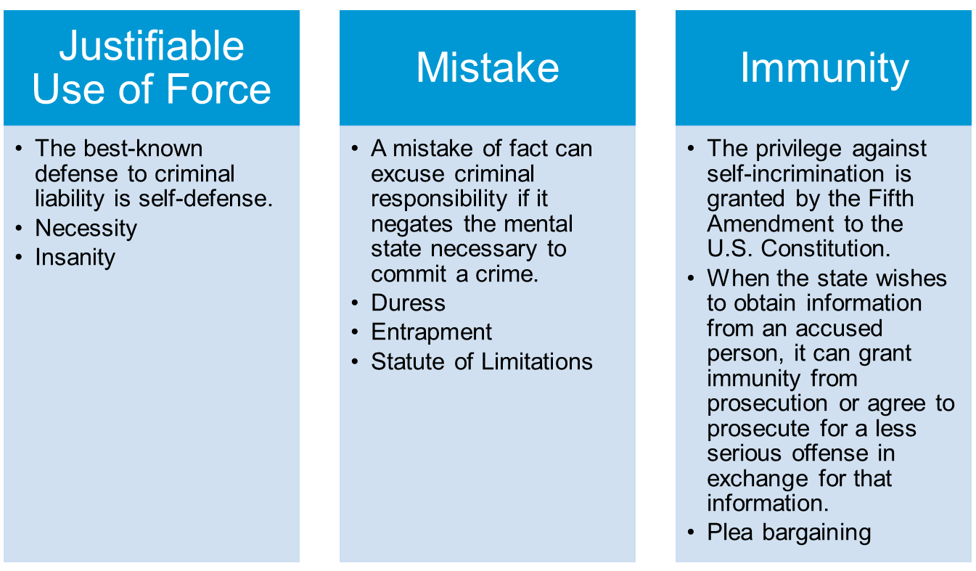
Defenses to Criminal Liability
Notes:
Notes:
Justifiable use of force: the best-known defense to criminal liability is self-defense.
Persons charged with crimes may be relieved of criminal liability, if they can show that their criminal actions were justified under the circumstances, or that they lack the required mental state.

Slide 18
Discussion (1 of 2)
One suggestion for alleviating the problem of “fraud sourced” money is to require proof of identity from anyone who wants to trade virtual items on online gaming platforms. Do you think this strategy would be successful?
Why, or why not?
Notes:
Divide students into small groups, and give them the following instructions to analyze and answer this discussion prompt:
Cybersecurity and the Law
Notes – According to “the displacement effect,” as some parts of an economy become more highly regulated, tainted funds move to the less regulated parts of the economy. Under federal banking laws, only “convertible virtual currency” (CVC) is subject to regulation designed to combat money laundering. To fall under the definition of a CVC, the virtual currency must have a value in real currency, or act as a substitute for real currency. This definition does not cover CS:GO’s container keys or, to give another example, the online survival contest Fortnite’s V-bucks. Consequently, these online video games will continue to attract some players who are laundering money.

Slide 19
United States v. Barta (2015)
George Castro told Ambrosio Medrano that a bribe to a certain corrupt Los Angeles County official would buy a contract with the county hospitals. To share in the deal, Medrano recruited Gustavo Buenrostro. In turn, Buenrostro contacted his friend James Barta, the owner of Sav–Rx, which provides prescription benefit management services. Barta was asked to pay a “finder’s fee” to Castro. He did not pay, even after frequent e-mails and calls with deadlines, and delivered ultimatums over a period of months. Eventually, Barta wrote Castro a Sav–Rx check for $6,500, saying that it was to help his friend Buenrostro. Castro was an FBI agent, and the county official and contract were fictional. Barta was charged with conspiracy to commit bribery. At trial, the government conceded that Barta was not predisposed to commit the crime.
Notes:
Could Barta be absolved of the charge on a defense of entrapment? Explain. (See Defenses to Criminal Liability.)

Slide 20
United States v. Barta (2015) Polling Question
Should Barta be charged with conspiracy to commit bribery?
Yes
No

Slide 21
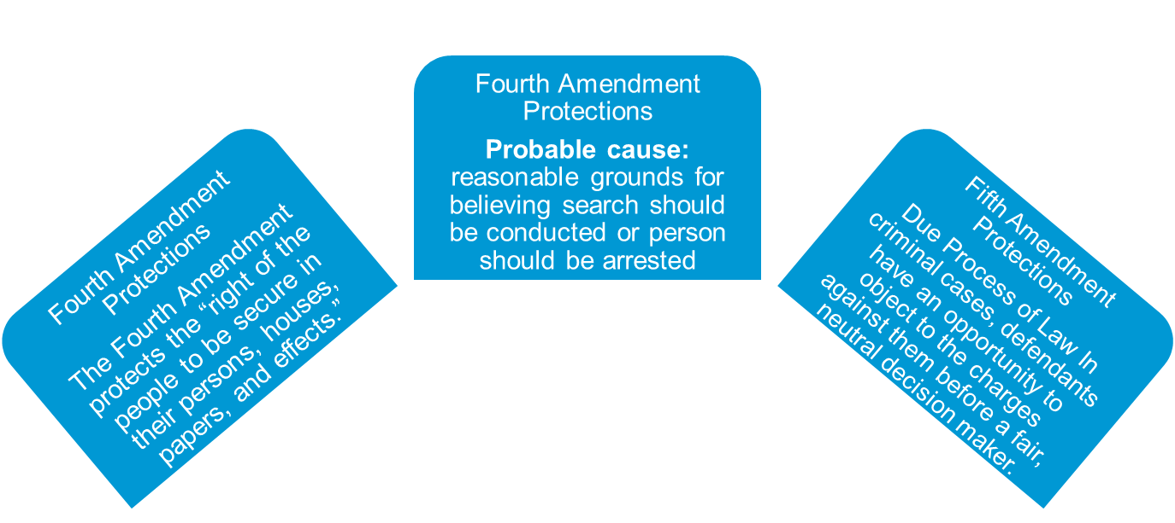
Constitutional Safeguards, Criminal Procedures and Fifth Amendment Protections
Notes:
The Fourth Amendment protects the “right of the people to be secure in their persons, houses, papers, and effects.”
Law enforcement officers must obtain a search warrant, an order from a judge or other public official authorizing the search or seizure of private property.
Reasonable expectation of privacy: the Fourth Amendment protects only against searches that violate a person’s reasonable expectation of privacy.
Double Jeopardy
The Fifth Amendment requirement that prohibits a person from being tried twice for same crime.
Self-Incrimination
An accused person cannot be compelled to give testimony that might subject her or him to criminal prosecution.
The Exclusionary Rule
A rule that prevents evidence that is obtained illegally, or without a proper search warrant from being admissible in court.
The purpose of the exclusionary rule is to deter police from conducting warrantless searches, and engaging in other misconduct.
If evidence of a defendant’s guilt was obtained improperly, it normally cannot be used against the defendant in court.

Slide 22
State of California v. Greenwood (1988)
Jenny Stracner, an investigator with the Laguna Beach (California) Police Department, enlisted the aid of a local trash collector in gathering evidence on suspect Billy Greenwood. Instead of taking Greenwood’s trash bags to be incinerated, the collector agreed to give them to Strancer. The officer found enough drug paraphernalia in the garbage to obtain a warrant to search Greenwood’s home, where she found illegal drugs. The United States Supreme Court upheld the search and Greenwood’s subsequent arrest.

Slide 23
State of California v. Greenwood (1988)
Polling Question
Do you feel that people have a reasonable expectation of privacy when it comes to the contents of garbage bags left on a curb?
Yes
No
Notes:
People do not, the Court reasoned, have a reasonable expectation of privacy when it comes to their garbage bags. The Court noted that when we place our trash on a curb, we expose it to any number of intrusions by “animals, children, scavengers, snoops, and other members of the public.” In other words, if Greenwood had truly intended to keep the contents of his garbage private, he would not have left it on the side of the road.

Slide 24
The Miranda Rule
The Miranda Rule
Based on Miranda v. Arizona (1966), the U.S. Supreme Court established that individuals who are arrested must be informed of their Fifth Amendment right to remain silent, and their Sixth Amendment right to counsel.
Exceptions to the Miranda Rule
  Public Safety
  Coercion
  Illegally obtained evidence
Notes:
Miranda v. Arizona (1966) Landmark in the Law – Police officers routinely advise suspects of their “Miranda rights” on arrest.

Slide 25
Criminal Process (1 of 3)
Arrest
Indictment or Information
  Indictment: a formal charge by a grand jury that there is probable cause to believe that a named person has committed a crime
  Information: a formal accusation or complaint issued in certain types of actions by a government prosecutor

Slide 26
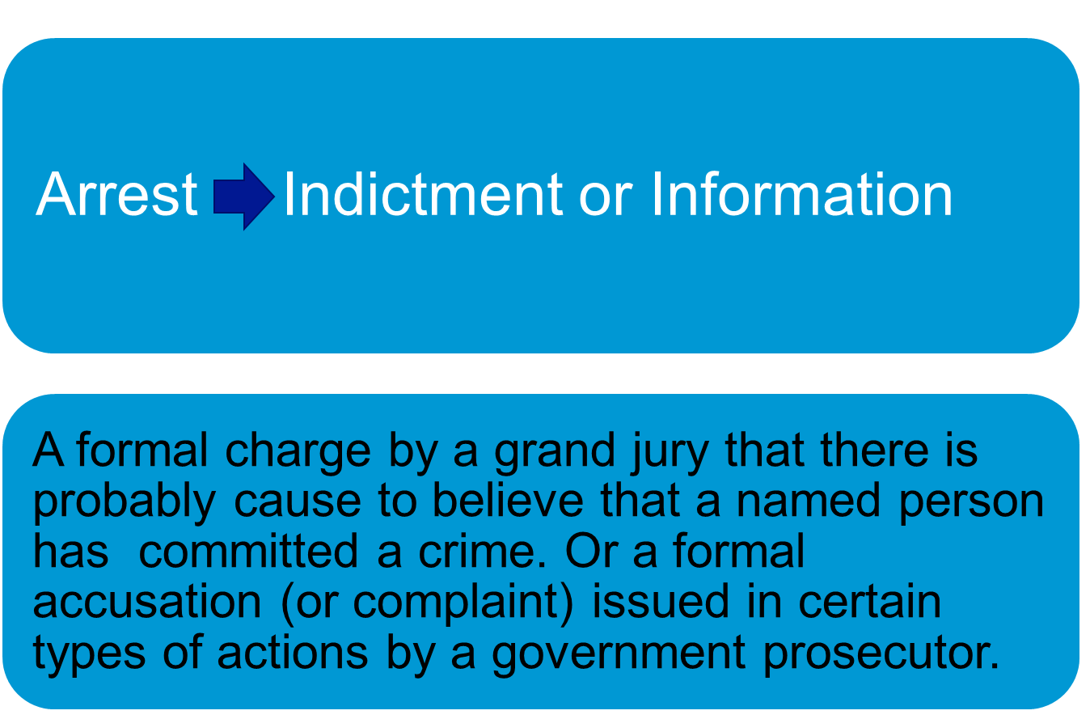
Criminal Process (2 of 3)

Slide 27
Criminal Process (3 of 3)
Trial:
The entire burden of proof is on the prosecutor (the state) who must show that, based on all the evidence presented, the defendant’s guilt has been established beyond a reasonable doubt.
If there is a reasonable doubt, then the verdict must be “not guilty.” (This is not the same as stating that the defendant is innocent.)
The U.S. Sentencing Commission’s guidelines establish a range of possible penalties, but judges are allowed to depart from the guidelines if circumstances warrant.

Slide 28
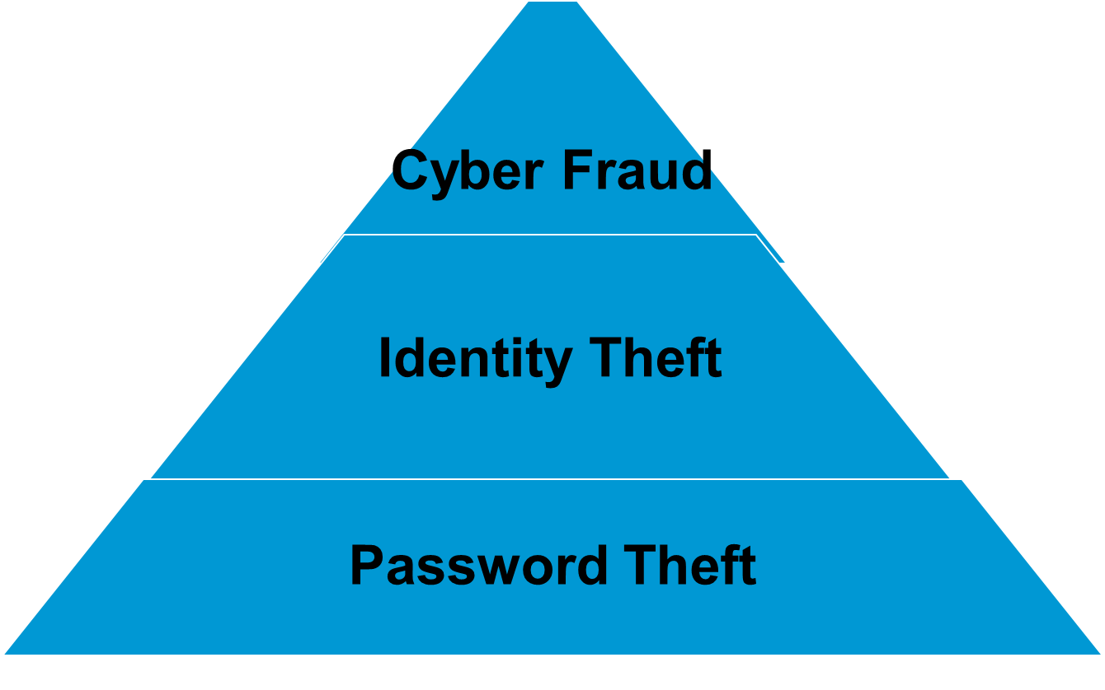
Cyber and Computer Crimes
Notes:
Invite the students to discuss the differences of each item here.
Computer crime: any violation of criminal law that involves knowledge of computer technology for its perpetration, investigation, or prosecution.
Many computer crimes fall under the broad label of cyber crime, or any criminal activity occurring in the virtual community of the Internet.
Cyber fraud: any misrepresentation knowingly made over the Internet with the intention of deceiving another for the purpose of obtaining property or funds.
Advance fee fraud and online auction fraud are two widely reported forms of cyber crime.
Identity Theft: illegal use of someone’s personal information to access the victim’s financial resources.
Easy access to personal information: website users surrender a wealth of personal information via website “cookies,” and their own disclosures on social media sites.
Stolen credit-card numbers: more than half of identity thefts involve the misappropriation of credit-card accounts.
Identity theft can be committed in the course of pursuing other criminal objectives.
Password Theft
Keystroke logging relies on software that embeds itself in a victim’s computer, and records every keystroke made on that computer.
Links that are contained within e-mails sent from unknown sources, and may sometimes be used to illegally obtain personal information.
Phishing: perpetrators send e-mails purporting to be from legitimate businesses to induce recipients to reveal passwords, personal financial data, or other information.

Slide 29
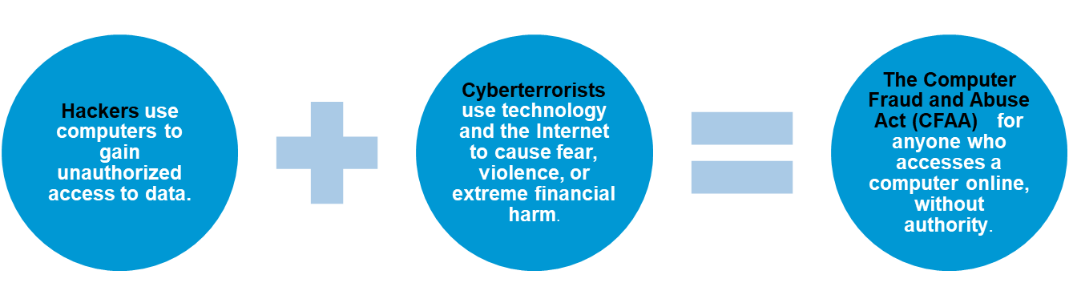
Cyber Crimes
Notes:
Botnets: network of compromised computers that are used to generate spam, and relay viruses
Malware: any harmful computer program
Worm: software that replicates itself to consume system resources
Virus: software that replicates itself to alter files, and interfere with normal operations
Service-Based Hacking: criminals now offer “crimeware as a service”

Slide 30
Discussion (2 of 2)
Without permission, Ben downloads consumer credit files from a computer belonging to Consumer Credit Agency. He then sells the data to Dawn. Has Ben committed a crime? If so, what is it? (See Cyber Crime.)
Notes:
Divide students into small groups, and give them the following instructions to analyze and answer this discussion prompt:
Check your answers to the Issue Spotters, against the answers provided in Appendix D.

Slide 31

Group Breakout: Botnets
Hackers can potentially take over automobile computer systems. What other everyday products and services are susceptible to hacking?
Notes:
Divide students into small groups, and give them the following instructions to analyze and answer this discussion prompt:
After Apple, Inc., introduced its mobile-payment system, cyber thieves began hacking into Apple mobile devices to make purchases with stolen credit card numbers. At about the same time, cyber criminals were stealing the credit card data of at least 60 million Home Depot customers, and illegally accessing the financial information of 76 million JPMorgan Chase clients. Hackers have also demonstrated that they can take over the dashboard computer systems that control cars. Additionally, the risk of takeover extends to numerous wireless-enabled medical devices, such as pacemakers and insulin pumps.

Slide 32

Knowledge Check Video: Steps of a Criminal Prosecution

Slide 33
Knowledge Check Video Question
What two elements normally must exist before a person can be held liable for a crime?
Notes:
Answer – Two elements normally must exist simultaneously for a person to be convicted of a crime: 1. the performance of a prohibited act (actus reus); and 2. a specified state of mind or intent on the part of the actor (mens rea).

Slide 34
Video Debrief
What does “reasonable doubt” mean to you?

Slide 35
Self-Assessment
What concepts did you find difficult, and thus need a review?
How might the topics in this chapter come up in the future in your personal (or work) life?
What could you do to improve your contributions in class discussion?

Slide 36
Summary
Now that the lesson has ended, you have learned to:
Differentiate between actus reus, and mens rea.
Identify types of white collar crime.
List available defenses to criminal activity.
Summarize the constitutional protections for the criminal defendant.
Explain the burden of proof required in a criminal case.
Summarize criminal liability under the Federal Computer Fraud and Abuse Act.

