Slide 1
Chapter 13
Capacity and Legality
Miller, Business Law Today Comprehensive Edition Text & Cases, 13th edition. © 2022 Cengage. All Rights Reserved. May not be scanned, copied or duplicated, or posted to a publicly accessible website, in whole or in part.

Slide 2
Chapter Objectives
By the end of this chapter, you should be able to:
Define capacity.
Summarize the capacity of a minor.
Define emancipation, in the context of contract law.
Describe the impact of mental capacity in determining the validity of a contract.
Explain how intoxication affects capacity.
Explain the legality requirement in contract law.
Define illegality in a contract.

Slide 3
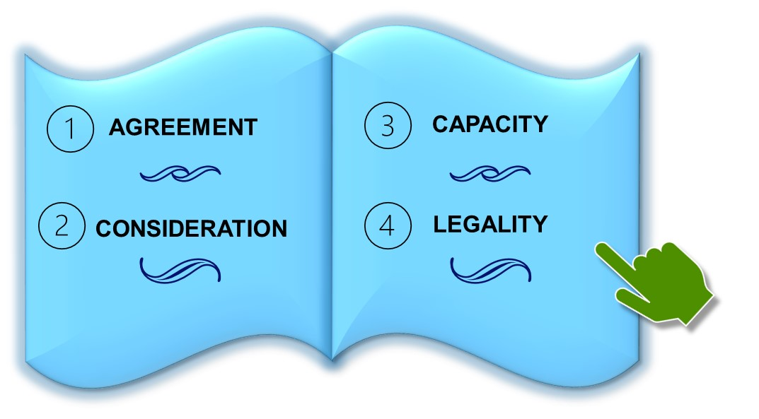
Why Does Capacity and Legality Matter?
Scenario: Sixteen-year-old Jane wants to free herself from her abusive parents. Can her parents relinquish their legal right to exercise control over Jane?
Notes:
Have students review the concept of contractual capacity, and answer the question on the slide. If Jane’s parents decide to grant Jane her wish to be free from their control, what would be the legal protocol for this to happen?
Answer: Responses will vary.

Slide 4
Minors or Infants
Not legally bound by contracts
Adult age begins at 18
Minority status terminated with emancipation
Avoid contracts by disaffirming with intent
Disaffirmance within a reasonable time
Obligations to return goods on disaffirmance
Necessaries
Ratification

Slide 5
PAK Foods Houston, LLC v. Garcia Polling Question
Can a minor disaffirm a contract at his or her option?
Yes
No
Explain your reasoning to another person or classmate.
Notes:
Have students review Case 13.1 PAK Foods Houston, LLC v. Garcia and discuss S.L.’s disaffirmance. What motivated her decision? What was the court’s decision and remedy?
Answer: Responses may vary.

Slide 6
Parent’s Liability
Not liable for contracts made by minor acting on their own
Necessaries, parents legally required to provide
Example: businesses require parents to cosign for liability

Slide 7
Intoxicated Persons
Lacking mental capacity, but other party knows it
Transaction may be voidable
Option for disaffirmance for a reasonable time upon sobriety
Consequences understood while intoxicated, then contract enforceable
Difficult to prove impaired judgment causing misunderstanding
Courts rarely permit avoiding contracts due to intoxication

Slide 8
Mentally Incompetent Persons
Contracts can be void, voidable, or valid
Court determines mental incompetence, making contract void
Without court, minor incompetent when contract formed, then voidable
Case Example 13.3 Annabelle Duffie
Contract valid if capacity present when contract formed
Notes:
Case Example 13.3 Annabelle Duffie was mildly mentally retarded, and at age seventy, had the beginning of dementia. For her entire life, she had lived with her brother, Jerome. When Jerome died, he left Annabelle his property, including 180 acres of timberland near Hope, Arkansas, which was valued at more than $400,000. Less than three months later, Annabelle signed a deed granting her interest in the tract to Charles and Joanne Black. The Blacks agreed to pay Annabelle $150,000 in monthly payments of $1,000. Later, Annabelle’s nephew, Jack, was appointed to be her legal guardian. On her behalf, Jack filed a lawsuit in an Arkansas state court against the Blacks, seeking to void the land deal because of Annabelle’s lack of mental competence. The court ordered the Blacks to return the property to Annabelle. They appealed. A state intermediate appellate court affirmed. The evidence showed that Annabelle had been incompetent her entire life. She lacked the cognitive ability to make the complex financial decisions involved in selling property. Therefore, the contract was voidable.

Slide 9
Knowledge Check 1
Courts always permit avoiding contracts due to intoxications.
True
False
Notes:
Answer: False. Courts rarely permit avoiding contracts due to intoxication.

Slide 10
Legality: Contracts Contrary to Statute
Contracts to commit a crime violate statute
Usury
Gambling
Licensing statutes for certain professions
Notes:
Example 13.4: Spencer buys an iPhone that he later discovers is counterfeit. Since the device is inauthentic, he could claim that there was no valid contract, due to inadequate consideration and fraud.

Slide 11
Business Law Analysis Activity: Creating Scenarios Determining If a Contract with an Unlicensed Party is Enforceable
Review the Business Law Analysis feature, and create a couple of similar scenarios.
Why would some companies do business with unlicensed parties?
Notes:
Have students to read and review the Business Law Analysis feature, and respond to the question on the slide. Students should create a couple of scenarios similar to the one provided, and analyze the pros and cons of doing business with unlicensed parties.
Answer: Responses may vary.

Slide 12
Legality: Contracts Contrary to Public Policy
Contracts in restraint of trade
Covenants not to compete, and the sale of an ongoing business
Covenants not to compete in employment contracts
Case Example 13.4 Dana Clement
Notes:
Case Example 13.5 Dana Clement was an administrator with Compassus, a hospice care provider in Houston. She left, taking a number of colleagues with her, to form a new branch of Crossroads Hospice in the same city. Compassus brought a number of claims, including conspiracy, against Crossroads, relying primarily on a covenant in Compassus’s contract with Clement that forbade her from soliciting Compassus workers for employment elsewhere. A Texas appellate court dismissed the lawsuit, ruling that Crossroads could not be held responsible for Clement’s actions. In large part, the court based its decision on the fact that Crossroads was unaware of the nonsolicitation covenant, when it hired Clement and the other former Compassus employees.

Slide 13
Group Breakout Discussion: Ethical Issue Are Expansive Noncompete Agreements Reducing Worker Mobility?
In your groups, create one or two concrete scenarios where noncompete agreements may be reducing worker mobility.
Discuss potential workplaces.
Discuss possible co-worker dynamics.
Discuss any possible legal issues that may arise.
Notes:
Ask students to read and review the Ethical feature, and respond to the discussion questions on the slide. Students should provide reasoning for each response, and apply relevant concepts of contract law and any ethical issues that may come about.
Answer: Responses may vary.

Slide 14
Enforcement Problems
Noncompete enforceability laws vary state by state
Examples:
California prohibits all noncompete covenants
Texas only considers it, if employee receives benefits
Courts only reform contracts to prevent undue burdens or hardships

Slide 15
Kennedy v. Shave Barber Co. Polling Question
Did Patricia Kennedy breach the noncompete provision of her employment contract with The Shave?
Yes
No
Explain your reasoning to another person or classmate.
Notes:
Have students review Case 13.2 Kennedy v. Shave Barber Co., and discuss whether Kennedy breached the noncompete covenant when she opened her own salon two miles down the street. What was the court’s decision and remedy?
Answer: Responses may vary.

Slide 16
Unconscionable Contracts or Clauses
The UCC incorporates unconscionability in provisions
Procedural unconscionability
Case Example 13.5 Lianna Saribekyan vs. BANA
Substantive unconscionability
Notes:
Case Example 13.6 Lianna Saribekyan placed diamonds, gold, and other collectibles in a safety deposit box at the Bank of America’s (BANA’s) Universal City, California, branch. A few months later, this branch was slated for closure. Without informing Saribekyan, bank employees drilled open her deposit box and placed its contents, unsecured, in storage for several days. Millions of dollars’ worth of the items went missing, including four bags of diamonds inventoried by BANA as “beads,” and a container full of gold that had been replaced with pennies. The trial court found BANA liable, but limited its payout to $2,460 because the bank’s Safety Deposit Rules and Regulations capped damages for negligence at ten times the safety deposit box’s annual rent. A California appellate court reversed, identifying a contract of adhesion. To support this conclusion, the court noted that the limitation of liability provision was “buried” in the small print of a five-page supplement to the original agreement, an addendum that Saribekyan was never shown. Furthermore, the court found BANA’s negligence so grievous that to limit damages in such a way would “shock the conscience.”

Slide 17
Exculpatory Clauses
Courts sometimes refuse to enforce due to unconscionability
Violation of Public Policy
Examples: Rental agreements, employment
Enforcement of Exculpatory Clauses
Reasonable
Do not violate public policy
Do not protect parties from liability for intentional misconduct

Slide 18
Discussion: Managerial Strategy Creating Liability Waivers That Are Not Unconscionable
What would be your strategy regarding liability waivers, if you were managing a business that relied on minors engaging in inherently dangerous activities?
Under what circumstances would you, as a business owner, choose to aggressively defend your business against a customer’s liability lawsuit?
Notes:
Ask students to read and review the Managerial Strategy feature, and respond to the discussion questions on the slide. Students should provide reasoning for each question, and apply the concepts of minors and unconscionability regarding contract law.
Answer: Responses may vary.

Slide 19
Holmes v. Multimedia KSDK, Inc. Polling Question
Was the language used in the exculpatory clause that Colleen Holmes signed clear in releasing all sponsors, their agents, and employees without exclusion from liability for future negligence?
Yes
No
Explain your reasoning to another person or classmate.
Notes:
Have students review Case 13.3 Holmes v. Multimedia KSDK, Inc., and discuss the clarity of the exculpatory clause on the form that Holmes signed. What was the court’s decision and remedy?
Answer: Responses may vary.

Slide 20
The Effect of Illegality
In pari delicto – both parties are equally at fault
Justifiable Ignorance of Facts
Courts won’t enforce contract, but allow parties to return to original positions
Members of Protected Classes
Only member can enforce violated contract

Slide 21
Knowledge Check 2
When both parties are equally at fault, it is called ____________.
ad hominem
ex parte
in pari delicto
Habeas corpus
1, 2, and 4
1 and 3
3 only
None of the above
Notes:
Answer: C

Slide 22
Withdrawal from an Illegal Agreement
Example 13.8 Marta and Andy
Severable or Divisible Contracts
Contract performance can be completed in parts or whole
Example 13.9 Cole
Fraud, Duress, or Undue Influence
Victimized party allowed to recover for performance, or its value
Notes:
Example 13.8 Marta and Andy decide to wager (illegally) on the outcome of a boxing match. Each deposits $1,000 with a stakeholder, who agrees to pay the winner of the bet. At this point, each party has performed part of the agreement. Before payment occurs, either party is entitled to withdraw from the agreement by giving notice to the stakeholder.
Example 13.9 Cole signs an employment contract that is valid, but includes an overly broad and thus illegal covenant not to compete. In that situation, a court might find the employment contract enforceable, but they will reform the unreasonably broad covenant by converting its terms into reasonable ones. Alternatively, the court could declare the covenant illegal (and thus void), and enforce the remaining employment terms.

Slide 23
Knowledge Check
Most obligations are discharged by full performance.
True
False
Notes:
Answer: True

Slide 24
Self-Assessment
What concepts did you find difficult, and thus need to review?
How might the topics in this chapter come up in the future in your personal (or work) life?
How can you use your personal (or work) experience to contribute for a class discussion on the topics in this chapter?
Which topics would you like to independently learn more about?

Slide 25
Summary
Now that the lesson has ended, you should have learned how to:
Define capacity.
Summarize the capacity of a minor.
Define emancipation, in the context of contract law.
Describe the impact of mental capacity in determining the validity of a contract.
Explain how intoxication affects capacity.
Explain the legality requirement in contract law.
Define illegality in a contract.

