Slide 1
Chapter 18
Third Party Rights
Miller, Business Law Today Comprehensive Edition Text & Cases, 13th edition. © 2022 Cengage. All Rights Reserved. May not be scanned, copied or duplicated, or posted to a publicly accessible website, in whole or in part.

Slide 2
Chapter Objectives
By the end of this chapter, you should be able to:
Define privity.
Identify the rights of third-party beneficiaries.
Describe the legal rights and obligations of parties to assignments and delegations.
Identify the restatement rule for liability to third parties.
Distinguish between intended and incidental beneficiaries.

Slide 3

Why Do Third Party Rights Matter?
Scenario: Nick obtains a loan from Northwest bank to buy a condo. Northwest Bank sends a letter stating that it has transferred its rights to receive payments to Central Bank. To whom does Nick have to make his monthly mortgage payments to now?
Notes:
Have students review the concept of privity of contract and assignment, and answer the scenario question on the slide. Students should also provide legal reasoning for their solution.
Answer: Responses will vary.

Slide 4

Assignments
Privity of contract
Transfer of contract rights to a third person
  Example 18.1 Kendra
Effect of an Assignment
Extinguishes the rights of the assignor
Assignee takes rights subject to defenses
Notes:
Example 18.1 Kendra obtains a loan from a bank to finance an online business venture. Later, she receives a notice from the bank stating that it has transferred (assigned) its rights to receive payments on the loan to another firm. When it is time to repay the loan, Kendra must make the payments to that other firm.

Slide 5
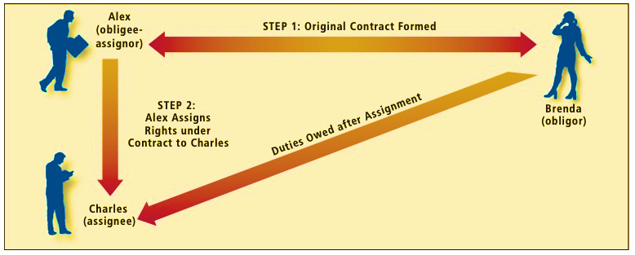
Exhibit 18-1 Assignment Relationships

Slide 6
JP Morgan Chase Bank N.A. v. McNeill
Polling Question
The contract between McNeill and Rodeo Ford provided that “any change to [it] must be in writing[,] and we must sign it.” Based on this provision, should the court have ruled in favor of McNeill?
Yes
No
Explain your reasoning to another person or classmate.
Notes:
Have students review Case 18.1 JP Morgan Chase Bank N.A. v. McNeill, and answer the question on the slide. Students should discuss the decision and remedy of the case, and apply the concept of assignment of rights under a contract.
Answer: Responses may vary.

Slide 7


Rights that Cannot be Assigned
When a statute expressly prohibits assignment
When a contract is personal in nature
    Example 18.4 Anton
When an assignment significantly changes the obliger’s risk or duties
    Example 18.5 Alice
Notes:
Example 18.4 Anton signs a contract to be a tutor for Marisa’s children. Marisa then attempts to assign to Roberto her right to Anton’s services. Roberto cannot enforce the contract against Anton. Roberto’s children may be more difficult to tutor than Marisa’s. Thus, if Marisa could assign her rights to Anton’s services to Roberto, it would change the nature of Anton’s obligation. Because personal services are unique to the person rendering them, rights to receive personal services are likewise unique and cannot be assigned.
Example 18.5 Alice has a hotel, and to insure it, she takes out a policy with Northwest Insurance Company. The policy insures against fire, theft, floods, and vandalism. Alice attempts to assign the insurance policy to Carmen, who owns a hotel in another city. The attempted reassignment is ineffective because it may substantially alter the insurance company’s duty of performance, and the risk that the company undertakes. An insurance company evaluates the particular risk associated with a specific party, and tailors its policy to fit that risk. If the policy were assigned to a third party, the insurance risk could be materially altered.

Slide 8
Knowledge Check 1
Rights cannot be assigned (1) when a statute expressly prohibits assignment, (2) when a contract is personal in nature, and (3) when an assignment significantly changes the obliger’s risk or duties.
True
False
Notes:
Answer: True.

Slide 9

When Contract Prohibits Assignment
Contract cannot prevent assignment of right to receive funds.
Ownership rights in real estate often cannot be prohibited because such a prohibition or alienation is contrary to public policy in most states.
Negotiable instruments (such as checks and promissory notes) cannot be prohibited.
For the sale of goods, right to receive payments on an account (or damages) for breach of contract may be assigned, even though the sales contract prohibits such an assignment.
  Example 18.6 Ramirez
Notes:
Example 18.6 Ramirez agrees to build a house for Amy. Their contract states, “This contract cannot be assigned by Amy without Ramirez’s consent. Any assignment without such consent renders the contract void.” This anti-assignment clause is effective, and Amy cannot assign her rights without obtaining Ramirez’s consent.

Slide 10


Notice of Assignment
Priority issues
  Example 18.7 Jason
Potential for discharge by performance to wrong party
  Example 18.8 Alexis
Notes:
Example 18.7 Jason owes Alexis $5,000 under a contract. Alexis first assigns the claim to Louisa, who does not give notice to Jason. Then Alexis assigns it to Dorman, who notifies Jason. In most states, Louisa would have priority because the assignment to her was first in time. In some states, however, Dorman would have priority because he gave first notice.
Example 18.8 Recall that Alexis, the obligee in Example 18.7, assigned to Louisa her right to collect $5,000 from Jason, and Louisa did not give notice to Jason. What will happen if Jason later pays Alexis the $5,000? Although the assignment was valid, Jason’s payment to Alexis will discharge the debt. Louisa’s failure to notify Jason of the assignment will cause her to lose the right to collect the $5,000 from Jason. Note that Louisa will still have a claim against Alexis for the $5,000. If Louisa had given Jason notice of the assignment, Jason’s payment to Alexis would not have discharged the debt.

Slide 11
Delegations
  Parties can transfer delegated duties.
  But some duties cannot be delegated when:
    Performance depends on personal skill or talents of obligor.
    Special trust has been placed in the obligor.
    Performance by third party will vary materially from obligee’s expectations.
    Contract expressly prohibits delegation.

Slide 12
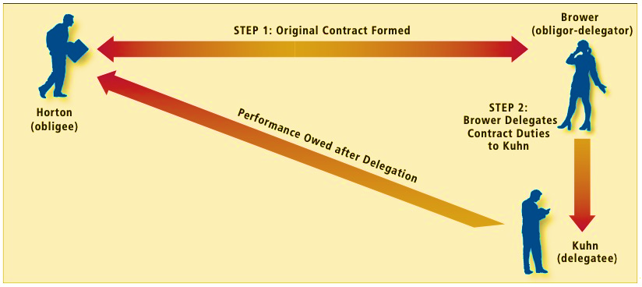
Exhibit 18-2 Delegation Relationships

Slide 13
Mirandette v. Nelnet, Inc.
Polling Question
The U.S. Court of Appeals for the Sixth Circuit reversed the district court’s dismissal of Mirandette’s suit.
Did the U.S. Court of Appeals for the Sixth Circuit remand the case for the lower court to consider Mirandette’s payment-on-receipt theory?
Yes
No
Explain your reasoning to another person or classmate.
Notes:
Have students review Case 18.2 Mirandette v. Nelnet, Inc., and answer the question on the slide. Students should discuss the decision and remedy of the case, and apply the reasoning of delegation and its effects.
According to the defendants’ reasoning, borrowers would have no contract remedies if loan servicers overcharged them. What effect might this circumstance have in the market for credit? Discuss.
Answer: Responses may vary.

Slide 14
“Assignment of All Rights”
Phrase can create both:
    Assignment of Rights and Delegation of Duties
“I assign the contract”
“I assign all my rights under the contract”
Assignor liable, if assignee fails to perform contractual obligations
Notes:
Have students research the UCC 2-210(1), (4); and Restatement (Second) of Contracts, Section 328 to learn more about the restatement rule.

Slide 15

Third Party Beneficiaries
Intended beneficiary
Party who made promise to benefit third party is the promisor
Classic Case example 18.14 Holly, Lawrence, and Fox
Notes:
Classic Case Example 18.14 The classic case that gave third party beneficiaries the right to bring a suit directly against a promisor was decided in 1859. The case involved three parties—Holly, Lawrence, and Fox. Holly had borrowed $300 from Lawrence. Shortly thereafter, Holly loaned $300 to Fox, who in return promised Holly that he would pay Holly’s debt to Lawrence on the following day. When Lawrence failed to obtain the $300 from Fox, he sued Fox to recover the funds. The court had to decide whether Lawrence could sue Fox directly (rather than suing Holly). The court held that when “a promise [is] made for the benefit of another, he for whose benefit it is made may bring an action for its breach.”

Slide 16
Bozzio v. EMI Group, Ltd.
Polling Question
In this case, the promisor was Capital Records. The promisee was Missing Persons, Inc., a corporation formed by the band members to receive the band’s royalties.
Could the third-party beneficiary sue for breach of contract, when the promisee lacked the capacity to bring the suit?
Yes
No
Explain your reasoning to another person or classmate.
Notes:
Have students review Case 18.3 Bozzio v. EMI Group, Ltd., and answer the question on the slide. Students should discuss the decision and remedy of the case, and apply the reasoning of third-party beneficiaries suing for breach of contract identifying the promisor and promisee.
Answer: Responses may vary.

Slide 17


Types of Intended Beneficiaries
Creditor beneficiary
  Case Example 18.15 Sharmalee
Donee beneficiary
  Example 18.16 Ben
Notes:
Case Example 18.15 Sharmalee Goonewardene filed a breach of contract lawsuit against ADP, a company that provided payroll services to her ex-employer, a travel agency called Altour. Goonewardene claimed that ADP was potentially liable for her unpaid wages under the third-party beneficiary doctrine. A California appeals court concurred by reasoning that ADP had contracted with Altour to perform a duty—the payment of salary— which was owed to Goonewardene. Therefore, she could sue ADP as a third-party beneficiary.
Example 18.16 Ben (the promisee) pays premiums to Standard Life, a life insurance company, and Standard Life (the promisor) promises to pay a certain amount on Ben’s death to anyone Ben designates as a beneficiary. The designated beneficiary is a donee beneficiary under the life insurance policy, and can enforce the payout promise made by the insurance company on Ben’s death.

Slide 18
Group Breakout Discussion Activity: Creating Scenarios
When the Rights of an Intended Beneficiary Vest
When third party demonstrates express consent to agreement, such as by sending a letter, a note, or an e-mail acknowledging awareness of, and consent to, the contract.
When third party materially changes position in detrimental reliance on contract, such as when a donee beneficiary contracts to have a home built in reliance on receipt of funds promised in a donee beneficiary contract.
When conditions for vesting are satisfied. For instance, rights of a beneficiary under a life insurance policy vest when insured person dies.
Notes:
Break students into small groups, and have them review the 18-3c section on When the Rights of an Intended Beneficiary Vest. Ask students to create scenario examples for each of the reasons listed on the slide.
The instructor can also provide examples and feedback.

Slide 19

Incidental Beneficiaries
  Third party receives benefit despite contract having other priorities
  Unintentional benefit, thus incidental beneficiary cannot sue
  Only intended beneficiaries acquire contractual legal rights
  Classic Case Example 18.17 Grand Prix Spectators
Notes:
Classic Case Example 18.17 Spectators who attended an automobile race (the Grand Prix) sued the organizations that presented the event. The spectators were upset because fourteen of the twenty cars that were supposed to race, dropped out at the last minute due to tire failures. The plaintiffs claimed that they were third party beneficiaries of the contract, between the teams of drivers and the race promoters. They sought compensation for traveling to and attending the race. However, the court dismissed the plaintiffs’ claims. “A failure to satisfy the subjective expectations of spectators at a sporting event is not actionable.” The defendants did not have a contract with the spectators, and the spectators could not sue as third-party beneficiaries.

Slide 20

Identifying Intended versus Incidental Beneficiaries
Performance rendered directly to third party
Third party has the right to control details of performance
Third party expressly designated as beneficiary in contract
Case Example 18.18 DASNY v. Samson and Perkins
Notes:
Case Example 18.18 New York City decided to build a fifteen-story forensic biology (DNA testing) laboratory next to Bellevue Hospital in Manhattan. The city turned the project over to the Dormitory Authority of the State of New York (DASNY), which oversees public projects. DASNY contracted with Perkins Eastman Architects, P.C., which hired Samson Construction Company to excavate the site and lay the foundation. Unfortunately, Samson’s excavation of the site caused adjacent structures, including a building, sidewalks, roadbeds, sewers, and water systems, to “settle,” causing about $37 million in damage.
DASNY and the city, sued Samson and Perkins, alleging breach of contract. Even though the city was not named in the contract between Samson and Perkins, a state appellate court held that the city was an intended third-party beneficiary. “The contract expressly states that a City agency will operate the DNA laboratory, and the City retained control over various aspects of the project.”

Slide 21
Knowledge Check 2
Which of the following is a true statement?
  Incidental beneficiaries do not receive benefits despite the contract having other priorities.
  Incidental beneficiaries cannot sue.
  Intended beneficiaries do not acquire contractual legal rights.
  None of the above.
Notes:
Answer: B

Slide 22

Knowledge Check Video: Third Party Rights

Slide 23
Knowledge Check Video Question
A third party beneficiary cannot sue the promisor directly.
True
False
Notes:
Answer: False

Slide 24
Video Debrief: Third Party Rights
Name some scenarios where third party beneficiaries would be involved, and the types of rights they could exercise.
Notes:
Students are welcome to conduct further research on their devices to produce examples of third party beneficiary cases.
Answer: Responses may vary.

Slide 25
Self-Assessment
What concepts did you find difficult, and thus need to review?
How might the topics in this chapter come up in the future in your personal (or work) life?
How can you use your personal (or work) experience to contribute for a class discussion on the topics in this chapter?
Which topics would you like to independently learn more about?

Slide 26
Summary
Now that the lesson has ended, you should have learned how to:
Define privity.
Identify the rights of third-party beneficiaries.
Describe the legal rights and obligations of parties to assignments and delegations.
Identify the restatement rule for liability to third parties.
Distinguish between intended and incidental beneficiaries.

